Slide 1


BELLABEAT
CASE STUDY : HOW CAN A WELLNESS TECHNOLOGYCOMPANY PLAY IT SMART? By : SEBIN V BABYCHEN

Slide 2
ABOUT THE COMPANY
URŠKA SRŠEN AND SANDO MUR FOUNDED BELLABEAT, A HIGH-TECH COMPANY THAT MANUFACTURES HEALTH-FOCUSED SMART PRODUCTS. SRŠEN USED HER BACKGROUND AS AN ARTIST TO DEVELOP BEAUTIFULLY DESIGNED TECHNOLOGY THAT INFORMS AND INSPIRES WOMEN AROUND THE WORLD. COLLECTING DATA ON ACTIVITY, SLEEP, STRESS, AND REPRODUCTIVE HEALTH HAS ALLOWED BELLABEAT TO EMPOWER WOMEN WITH KNOWLEDGE ABOUT THEIR OWN HEALTH AND HABITS. SINCE IT WAS FOUNDED IN 2013, BELLABEAT HAS GROWN RAPIDLY AND QUICKLY POSITIONED ITSELF AS A TECH-DRIVEN WELLNESS COMPANY FOR WOMEN.

Slide 3
BUSINESS TASK
To gain insight into the trends of smart-device usage that could be applied to Bellabeat customers and influence the company's marketing strategy.

Slide 4
Data source
The Dataset Used For This Analysis Can Be Accessed At
FitBit Fitness Tracker Data CCO : Public Domain, Dataset Made Available Through MOBIUS Kaggle's Profile.
Data Integrity & Limitations :
The Data Is From 2016, Trends And Patterns May Have Changed Over The Last 6 Years.
The Data Sample Is Only Of 30 Individuals, The Scope Of The Analysis And Reliability Of The Results Are Limited.
The Data Seems To Be Missing Some Metadata Information .

Slide 5
The Data Is Processed By :
Eliminating All The Duplicate Values
Deleting All The Null And Empty Cells
Formatting Data Sets Into A Readable Datatype
Converted Character To Only Date And Removed Time
Sorted And Filtered Out The Unique Values From The Datasets

Slide 6
TO ENSURE ACCURACY OF THE DATA PROVIDED.
The Correlation Between Totalsteps Taken And Totaldistance Were Calculated, The Results Was 0.984679651
The Correlation Between Totalsteps Taken And Totaldistance Traveled Is Inserted On A Scatterplot
The Total Steps Taken Is Highly Correlated To The Total Distance Traveled

Slide 7
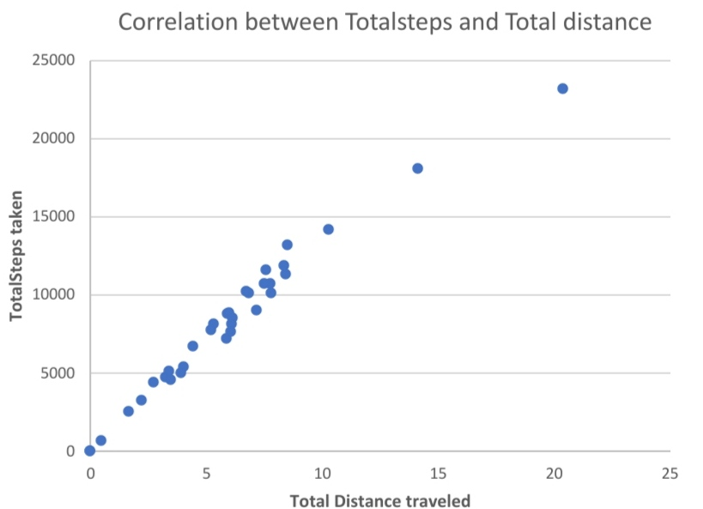

Slide 8
The Data Is Analysed By Calculating
THE MEAN WEIGHT
THE MEAN BMI
THE MEAN STEPS
THE MEAN TIME ASLEEP
THE MEAN TIME IN BED
THE MEAN PERCENTAGE TIME ASLEEP

Slide 9
AS OF THE CALCULATIONS :
The mean weight = 77.98749971
The mean BMI = 28.05125022
THE BMI IS CATEGORIZEDINTO INTO 4 TYPES :
Under weight = BMI less than 18.5
Healthy = BMI between 18.5 & 24.9
Over weight = BMI between 25 & 29.9
Obese = BMI over 30
THE RESULTS FROM THE ANALYSIS ARE;
BMI Category | Population
Under weight | 0
Healthy | 3
Over weight | 4
Obese | 1

Slide 10
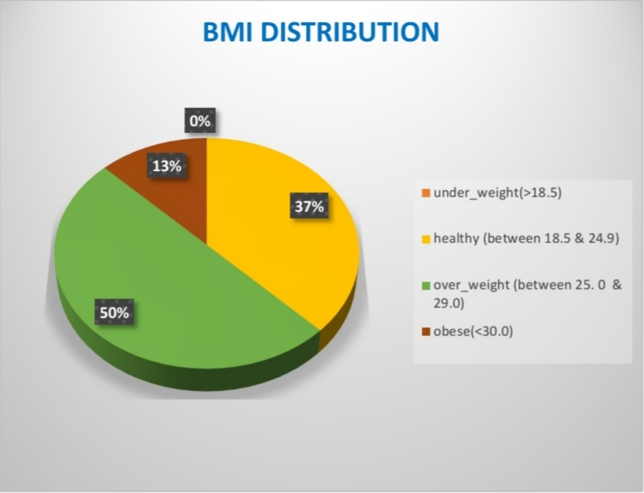
Graphical representation of the analysis
Total of 7 users (87% of sample population) have BMI in the “healthy” and “overweight” categories

Slide 11
The mean steps = 8236.848485
According to the total steps the activity level is categorized into 4 type :
Sedentary = Less than 1000 steps
Lightly active = Greater than or Equal to 1000 & Less than 10000 steps
Considered active = Greater than or Equal to 10000 & Less than 23000 steps
Highly active = Greater than or Equal to 23000 steps
Results from analysis are
Activity categorize | Population 2
Sedentary | 3
Lightly active | 18
Considered active | 11
Highly active | 1

Slide 12
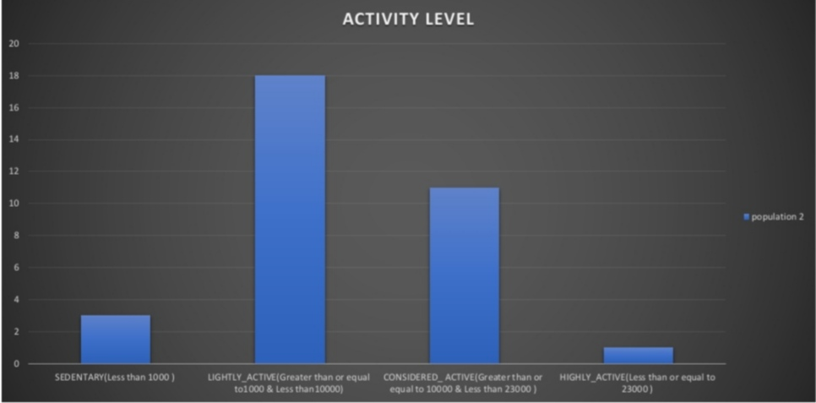
Graphical representation of Analysis
Among the 33 unique profiles, 54.5% of the sample population are lightly active and 33.3% are considered active.

Slide 13
The Mean Time Asleep = 390.6666667
The Mean Time In Bed = 432.3
According to the percentage of mean time asleep the sleep efficiency is categorized into 2 ;
Good sleep efficiency = percentage of mean time asleep greater than 85
Lousy sleep efficiency = percentage of mean time asleep less than 85
Results from the analysis are
Sleep efficiency | Population
Good sleep efficiency | 22
Lousy sleep efficiency | 2

Slide 14
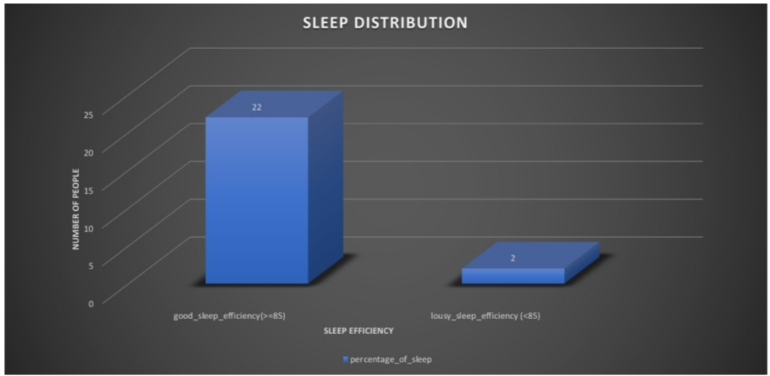
Graphical representation of analysis
91.6% of the sample population has good sleep efficiency also, Individuals with good & moderate BMI and daily activity will have a better sleep efficiency.

Slide 15
RECOMMENDATIONS :
BELLABEAT'S MARKETING STRATEGY TARGETS;
Individuals who have BMI measurement of between healthy and overweight.
Individuals who have daily activity level of between lightly active and considered active.
Individuals who have good sleep efficiency
SETUP ONLINE MARKETING CAMPAIGN TO ADVERTISE BELLABEAT PRODUCTS TO INDIVIDUALS WHO FITS THE TARGET CONSUMER PROFILE.
PARTICIPATE IN HEALTH FORUM OR SYMPOSIUM TO TARGET INDIVIDUALS WHO ARE CONSIOUS ABOUT HEALTH AND WOULD EITHER LIKE TO MAINTAIN OR IMPROVE THEIR HEALTH.
4. COLLABORATION WITH GYMS OR YOGA STUDIOS TO MARKET THE PRODUCT TO ACTIVE
INDIVIDUALS

Slide 16
THANK YOU

